Slide 1
ESTIMATION OF LAND SURFACE TEMPERATURE

Slide 2
Introduction & Problem Definition
• Urban Heat Island (UHI) Effect:
Urban areas are significantly warmer than rural ones due to reduced vegetation and increased artificial surfaces.
• Problem:
Satellite thermal infrared sensors provide low spatial resolution, limiting fine-scale urban analysis.
Higher-resolution multispectral data exist (~10m), but they lack thermal bands.
Accurate air temperature estimation at street level requires downscaling thermal data.
• Goal:
Downscale Landsat 8 LST data (30m) using Sentinel-2 multispectral data (10m) to generate high-resolution temperature maps.

Slide 3

Proposed Solution & Methodology
• Techniques Used:
• Multiple Linear Regression: Predict LST using NDVI, NDBI, and NDWI indices.
• Residual Correction: Improve predictions by adding regression residuals.
• Google Earth Engine (GEE): Cloud-based platform for efficient data processing.

Slide 4
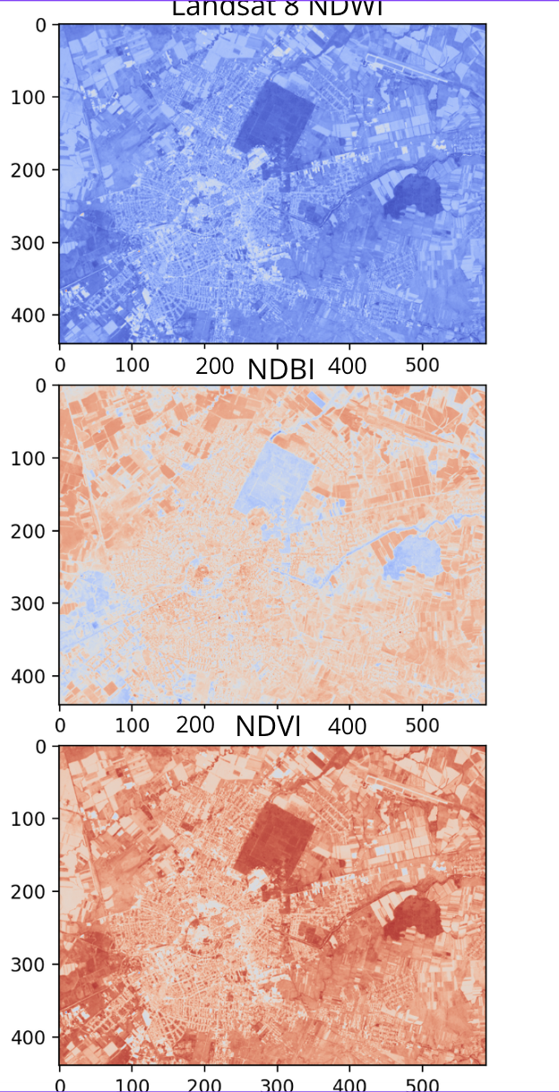
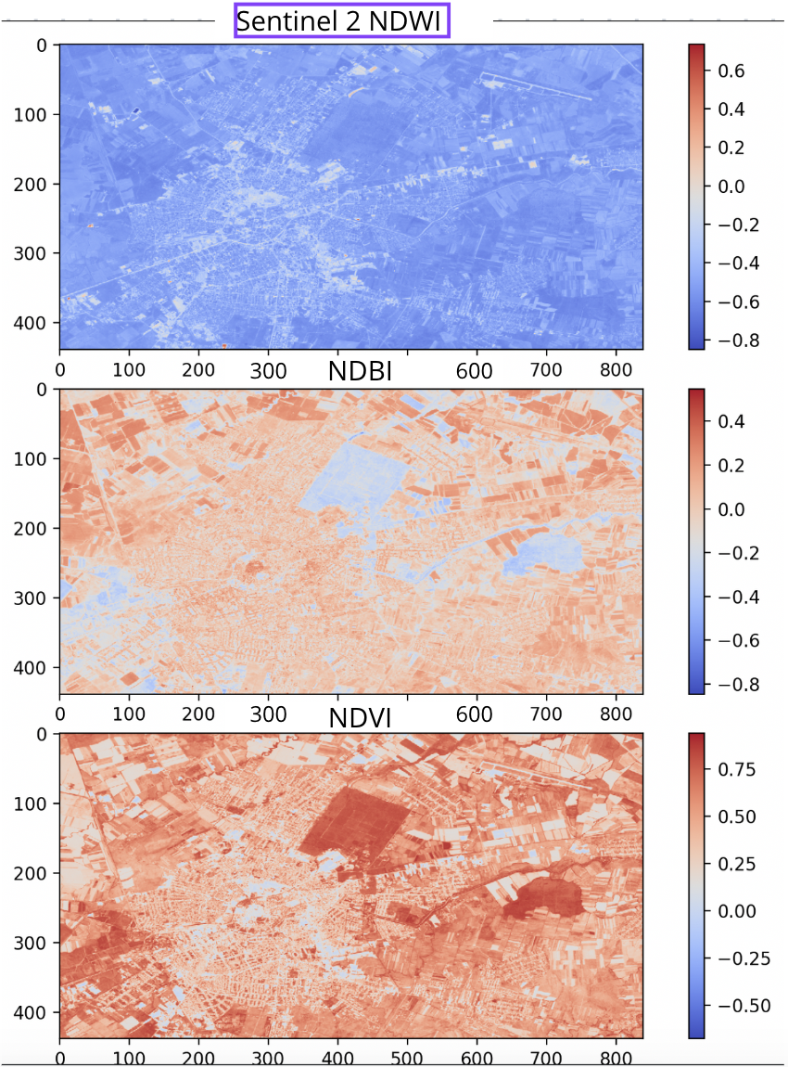

Slide 5
Proposed Solution & Methodology
• Workflow:
1. Compute Spectral Indices: NDVI, NDBI, NDWI from Landsat 8 (30m) and Sentinel-2 (10m).
2. Train Regression Model: Use Landsat 8 indices and LST to build a prediction model.
3. Apply Model to Sentinel-2 Data: Predict LST at 10m resolution.
4. Residual Correction: Add residuals to improve accuracy.
5. Validation: Compare results with in situ measurements and visual analysis.

Slide 6
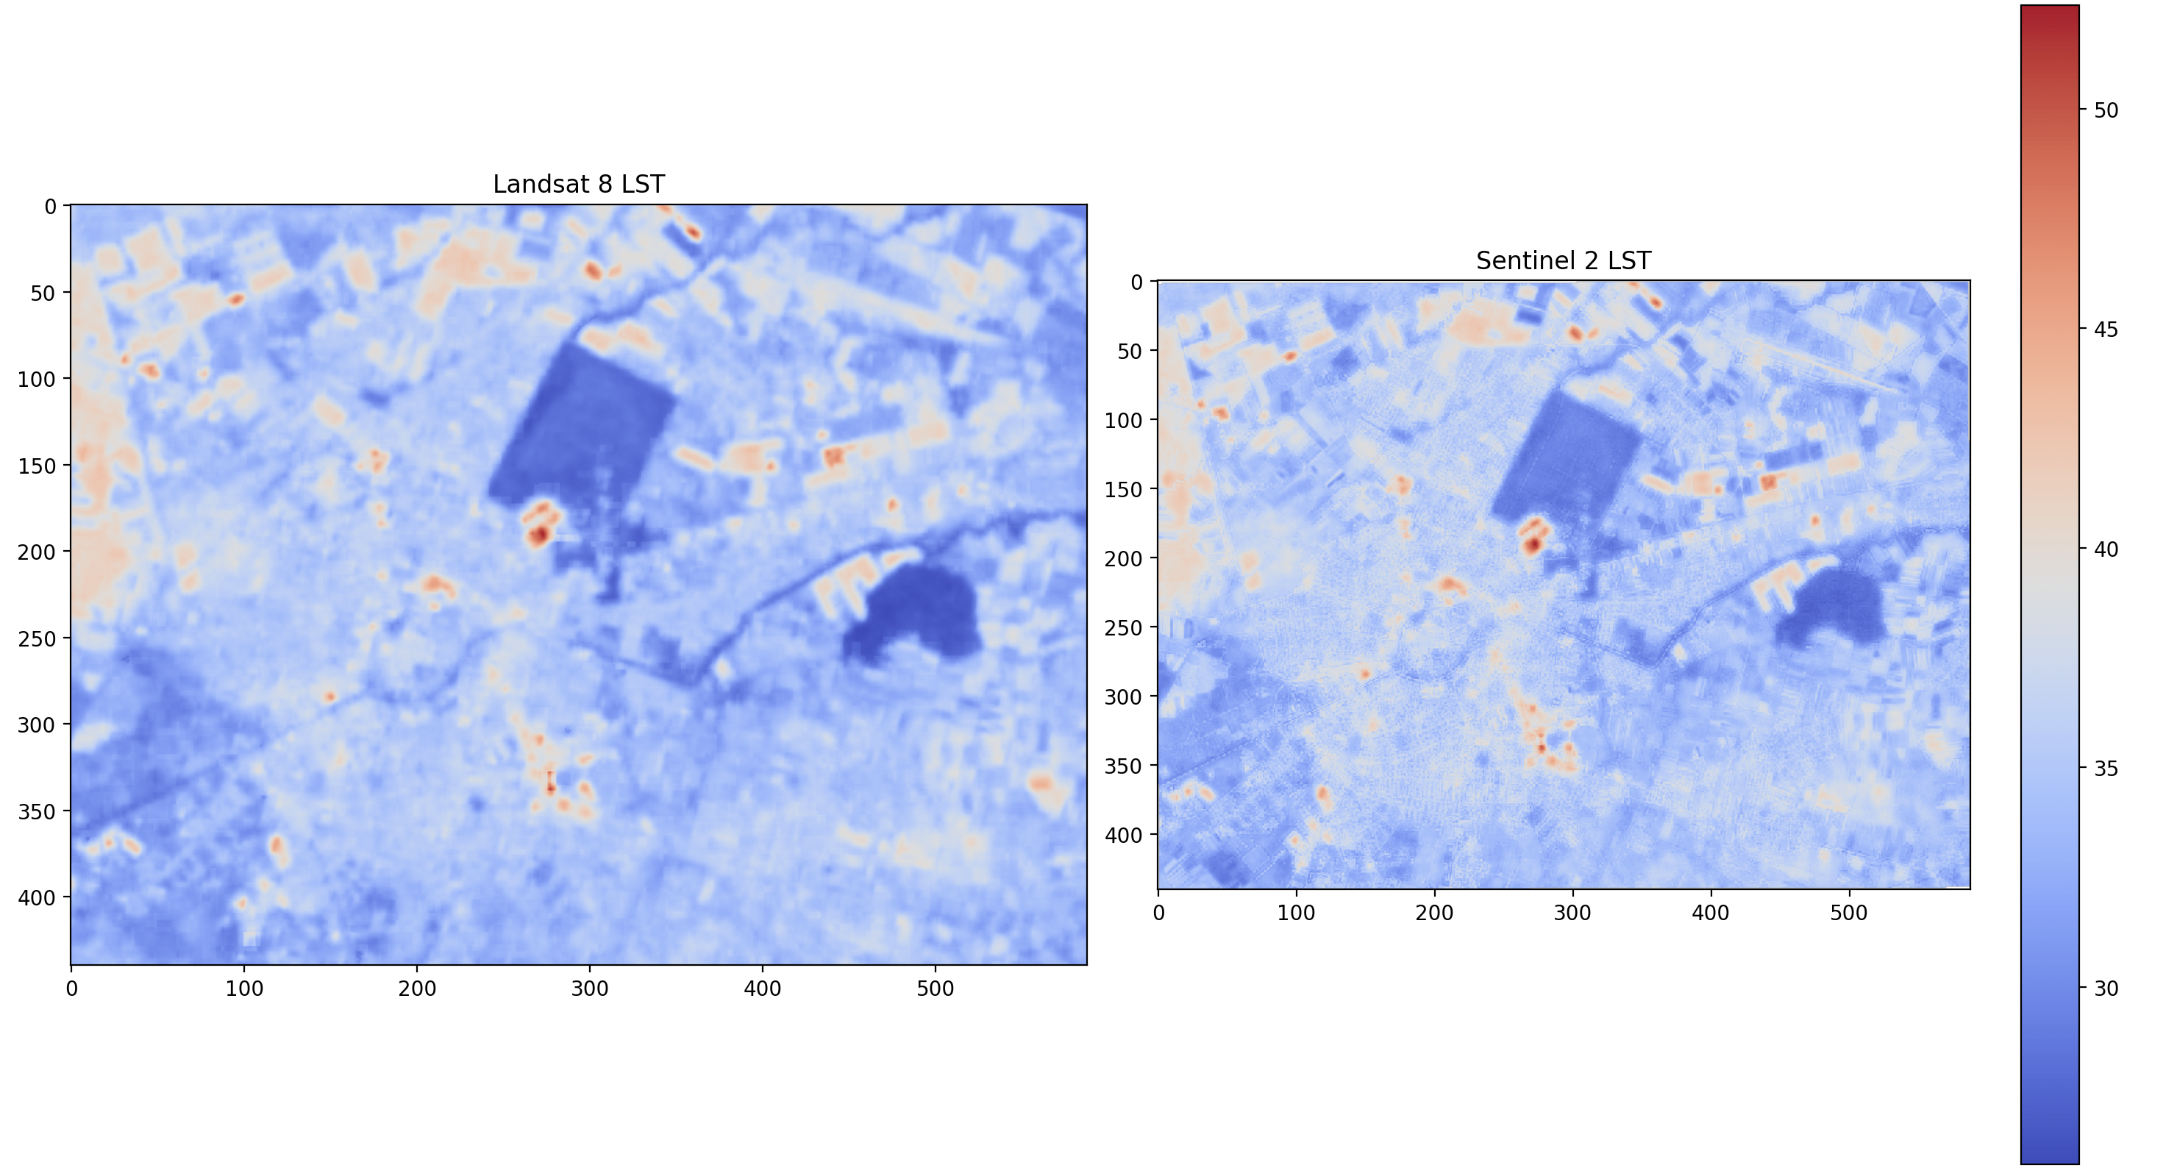

Slide 7
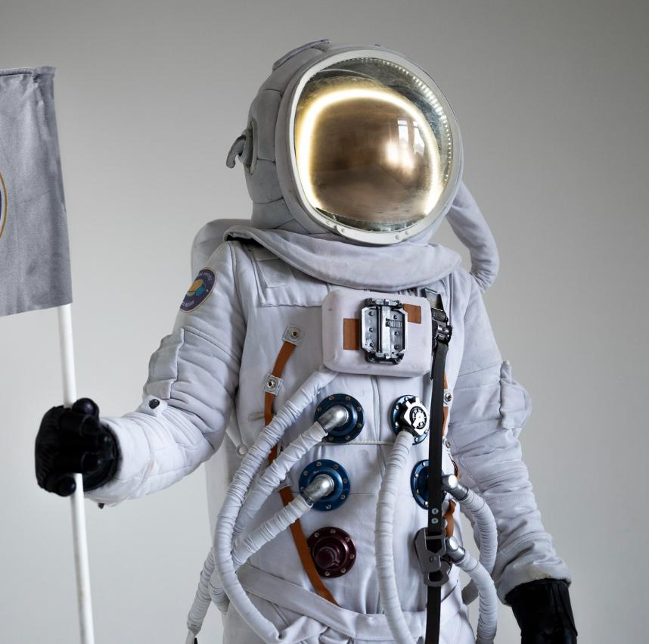
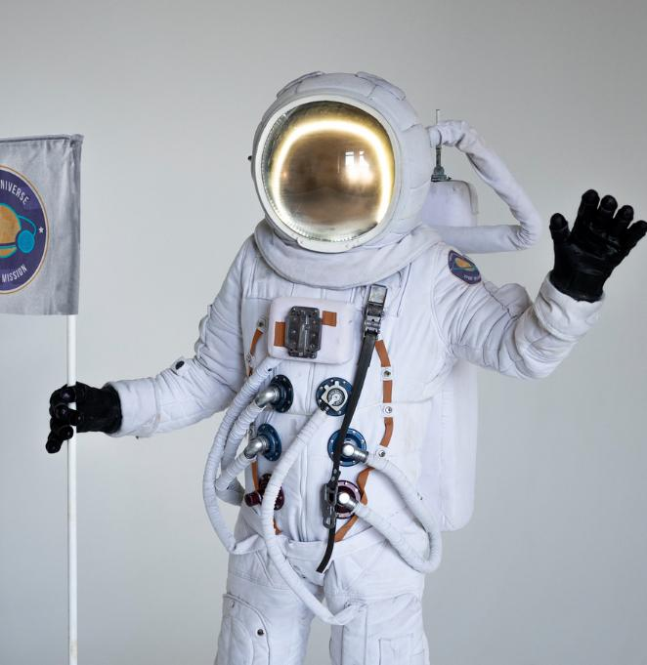
OUR TEAM
CHIPER
ROBERTO-MARIAN
COJAN
ALEXIA ILARIA
DIACONESCU
ANDREI-MIHAI

Slide 8
BIBLIOGRAFIE
The following resources were essential in the development of our application:
1. Google Earth Engine API (ee)
The Google Earth Engine API provided a powerful platform for accessing and processing large-scale satellite data.
Its cloud-based infrastructure allowed us to efficiently handle multispectral and thermal imagery from Landsat 8 and Sentinel-2 missions.
Link: Google Earth Engine Documentation
2. Python Programming Language
Python was used as the primary programming language for implementing our workflow.
3. Copernicus Open Access Hub
Sentinel-2 data were obtained from the Copernicus Open Access Hub, which provides free access to high-resolution
multispectral imagery for environmental monitoring.
Link: Copernicus Open Access Hub
4. Landsat 8 Data (USGS EarthExplorer)
The Landsat 8 data used for retrieving land surface temperature were sourced from the USGS EarthExplorer platform.
Link: USGS EarthExplorer
5. Research Article
The methodology and approach for downscaling land surface temperature were inspired by research on integrating Landsat and Sentinel data for high-resolution LST mapping:
Link: Research Article DOI

Slide 9
DEMO

Slide 10
Code Overview

Slide 11
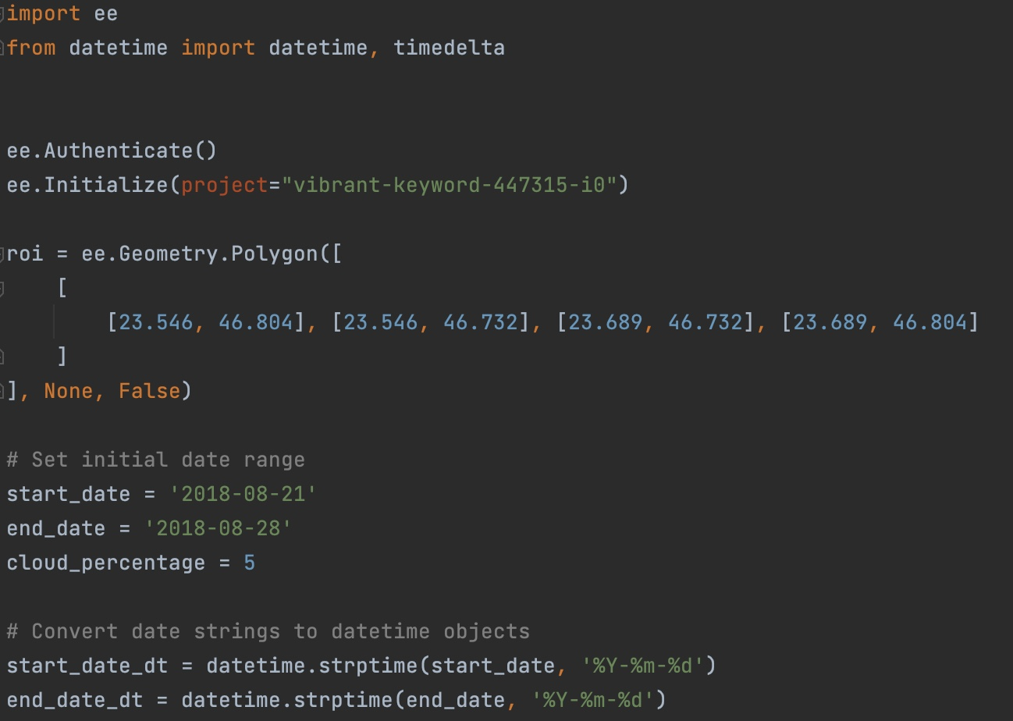
We initialize the Earth Engine API using ee.Authenticate() and ee.Initialize()
Region of Interest (ROI): The area of interest is defined using a polygon with four coordinates.
Date Range: The code specifies a start and end date for selecting satellite images.
Cloud Percentage: We set a threshold of 5% for the maximum cloud cover in the selected images to ensure data quality.

Slide 12
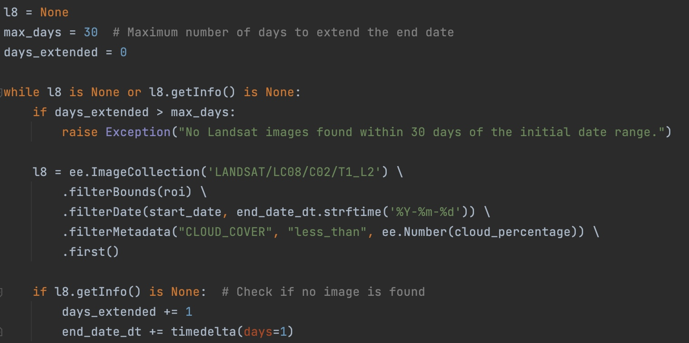
Finding a Cloud-Free Landsat 8 Image
Loop to Find an Image: The loop checks for cloud-free Landsat 8 images within the specified ROI and date range. If no suitable image is found, the end date is incrementally extended by one day until an image is found or a maximum of 30 days is reached.

Slide 13
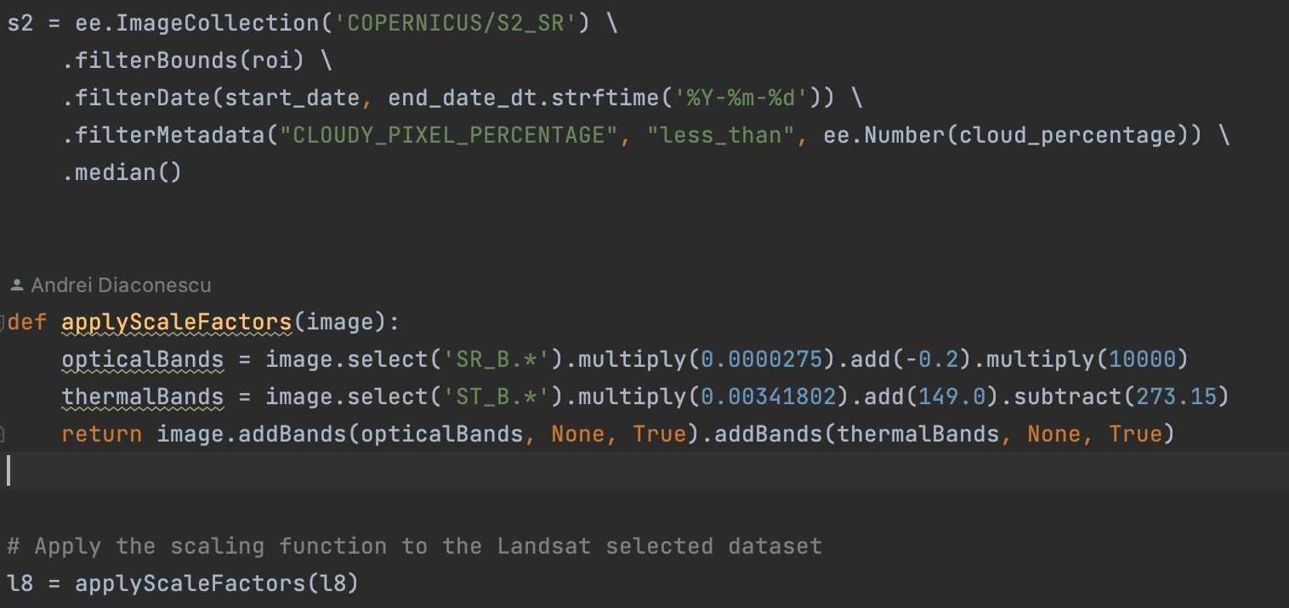
Sentinel-2 Image Collection: We filter Sentinel-2 images by ROI, date range, and cloud cover percentage
Median Composite: The median() function combines multiple images into a single image by taking the median value for each pixel, which helps reduce noise from clouds or atmospheric effects.
Applying Scale Factors
Purpose: Landsat data require scaling to convert raw values to meaningful reflectance and temperature values.
Optical Bands: The scaling factors are applied to the surface reflectance bands (SR_B.*).
Thermal Bands: For the thermal band (ST_B.*), scaling is applied to convert digital numbers to temperature in degrees Celsius.

Slide 14
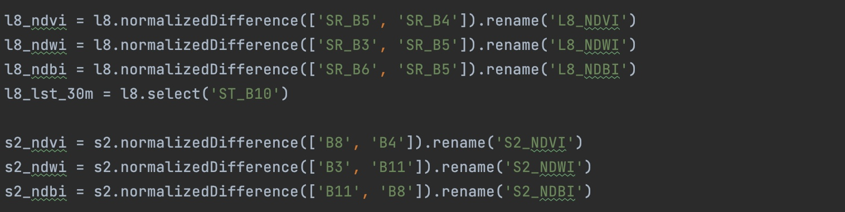
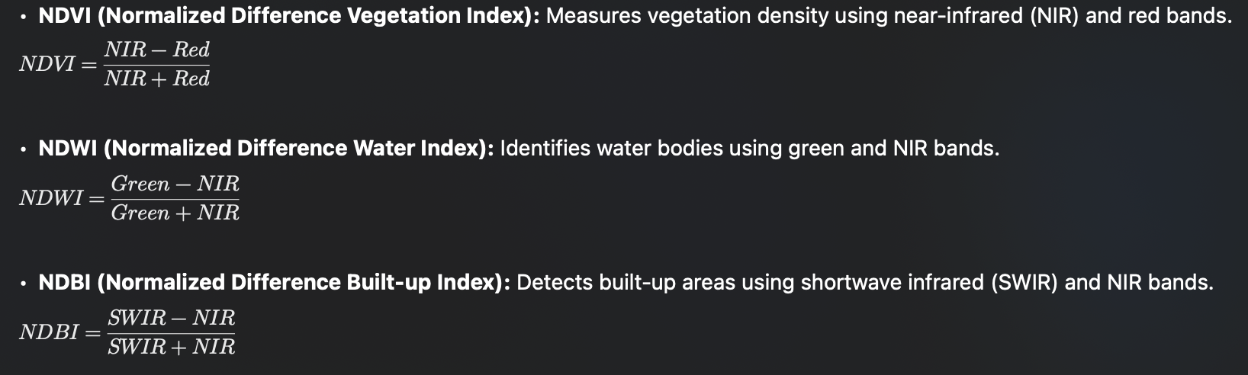
NDVI (Normalized Difference Vegetation Index)
Measures vegetation density using near-infrared (NIR) and red bands.
NDWI (Normalized Difference Water Index)
Identifies water bodies using green and NIR bands.
NDBI (Normalized Difference Built-up Index)
Detects built-up areas using shortwave infrared (SWIR) and NIR bands.

Slide 15
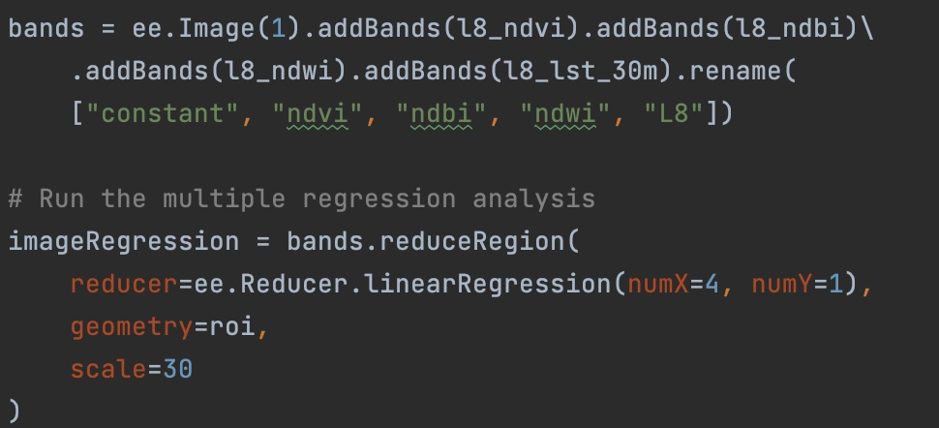
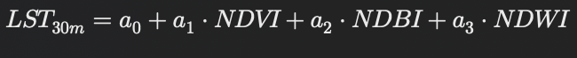
Linear Regression:
ee.Image(1) , a band with a value of 1 for each pixel (to estimate the intercept (a0) of the regression model).
We then add the three spectral indices derived from Landsat 8: (NDVI, NDBI, NDWI) , and l8_lst_30m, which is the observed land surface temperature (LST) at a 30m resolution.
The linear regression model has three predictors (NDVI, NDBI, NDWI) to predict LST. The regression equation is:

Slide 16
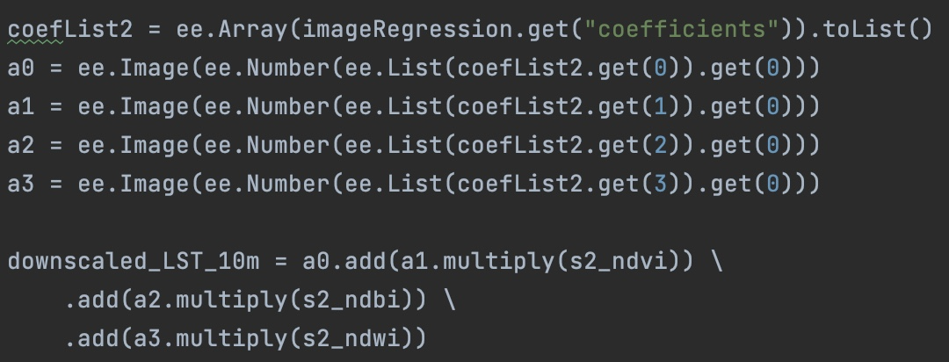
Extract Coefficients:
The regression coefficients a_0, a_1, a_2, a_3
are extracted from the model.
Downscaling LST to 10m Resolution
The regression equation derived from Landsat 8 data is now applied to the
high-resolution (10m) Sentinel-2 indices (s2_ndvi, s2_ndbi, s2_ndwi) to predict land surface temperature at a finer resolution (10m).

Slide 17
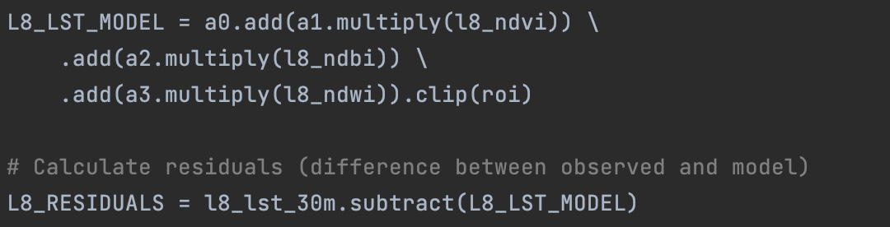

Purpose:
These residuals capture the errors or deviations in the model’s prediction and are crucial for improving the accuracy of the downscaled LST.
L8_LST_MODEL is the predicted LST at 30m resolution based on the regression equation applied to the Landsat 8 indices
(l8_ndvi, l8_ndbi, l8_ndwi).
• The residuals (L8_RESIDUALS) are calculated as the difference between the observed LST (l8_lst_30m) and the predicted LST (L8_LST_MODEL).

Slide 18
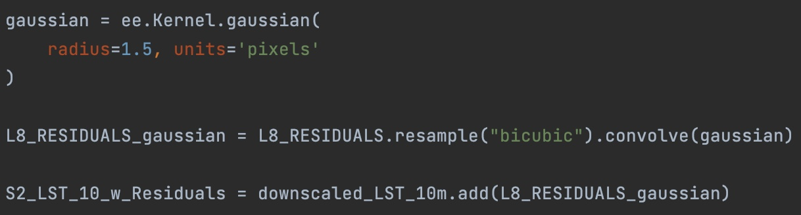

Purpose:
This correction step ensures that the downscaled LST matches the observed LST at 30m resolution when aggregated, thus improving the overall accuracy and ensuring energy conservation across scales.
A Gaussian kernel is defined with a radius of 1.5 pixels. This kernel is used to smooth the residuals by applying a convolution operation.
resample("bicubic") ensures that the residuals are resampled smoothly before applying the convolution.
The smoothed residuals (L8_RESIDUALS_gaussian) help correct finer-scale errors in the downscaled LST prediction.
The final downscaled LST at 10m resolution is obtained by adding the smoothed residuals to the initial downscaled LST prediction

Slide 19
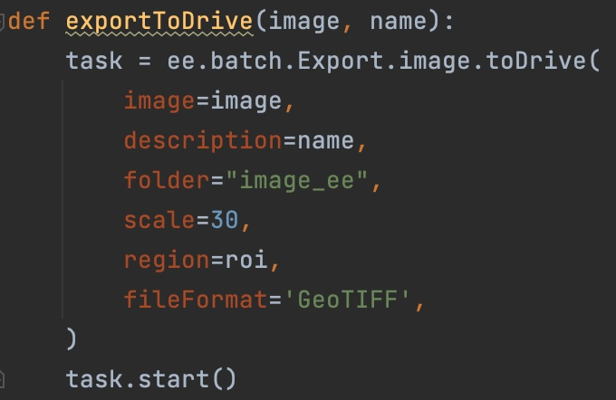
Export: The final downscaled LST map is exported as a GeoTIFF file to Google Drive

